Slide 1

CSBB 352 : Theory Of App Development (Presentation)
EchoNIT :-Theory of
App Development
Submitted to : Dr Karan Verma
By :
Anupam Anand (23)
Adarsh Raj (07)
Ankit Jha(20)
Department Of Computer Science And Engineering
NATIONAL INSTITUTE OF TECHNOLOGY DELHI​
2024 ​

Slide 2

Content
1. Introduction
2. Problem Statement
3. Purpose and Future Scope
4. Diagrams and Models used
5. Importance
6. Testing
7. Conclusion

Slide 3

Introduction
"Design and Implementation of EchoNIT: A Secure and Scalable Messaging Application" This topic focuses on the architecture, security features, and scalability aspects of EchoNIT.
"Building Real-Time Communication: A Case Study of EchoNIT Messaging App" This would focus on the real-time messaging features, including handling message delivery, push notifications, and latency reduction.
"Exploring User-Centered Design in EchoNIT: Building a Seamless Messaging Experience" If you want to focus on the UI/UX aspects, this topic would dive into how EchoNIT addresses user needs and preferences.
"Implementing End-to-End Encryption in EchoNIT: A Study on Privacy and Security" If privacy and security are key components, this could be a deep dive into how the app ensures secure communication.
"Optimizing EchoNIT for Cross-Platform Messaging: Challenges and Solutions" This could explore the challenges and solutions around making EchoNIT a cross-platform app (Android, iOS, Web).
"EchoNIT: Leveraging Cloud-Based Solutions for Efficient Messaging" This could look at how cloud infrastructure is used for message storage, scalability, and reliability.

Slide 4
Problem Statement
Communication Gap – Lack of a centralized platform for students, faculty, and administration to communicate effectively.
Event Awareness – Difficulty in keeping students informed about college events, workshops, and important announcements.
Resource Access – No streamlined way to access study materials, previous year question papers, and academic resources.
Attendance & Academic Tracking – Students struggle to track their attendance, grades, and academic progress efficiently.
Club & Society Engagement – Limited interaction between students and various college clubs due to the absence of a dedicated space for updates and collaborations.
Placement & Internship Updates – Lack of a dedicated platform for placement-related notifications, company visits, and internship opportunities.
Lost & Found – No structured system to report and retrieve lost items on campus.
Peer-to-Peer Interaction – Limited networking opportunities among students for discussions, group projects, and queries.
Emergency Alerts – No quick alert system for emergency notifications related to security, health, or campus closures.
Feedback Mechanism – Absence of a structured way to provide feedback on college facilities, faculty, and overall student experience.

Slide 5
Objective
The primary objective of the Echo NIT App is to create a centralized digital platform that enhances communication, academic accessibility, student engagement, and campus connectivity within the institution. The app aims to bridge the gap between students, faculty, and administration by providing real-time updates, academic resources, event notifications, and essential campus services in a user-friendly and efficient manner.
Enhance Accessibility:
Centralized Information Access – One-stop platform for announcements, academics, and events.
User-Friendly Interface – Intuitive and easy-to-navigate design.
24/7 Academic Resources – Digital repository for notes, study materials, and past papers.
One-Tap Support & Feedback – Quick reporting of issues and feedback sharing.
Provide Real-Time Information:
Instant Notifications – Timely alerts for announcements, events, and updates.
Live Placement & Internship Updates – Real-time job opportunities and company visit details.
Emergency Alerts – Immediate notifications for security, health, and urgent campus updates.
Streamline Live News :
Push Notifications – Immediate alerts for urgent and high-priority news.
Student & Faculty Contributions – Option for verified users to share important news.
Multi-Format Content – Support for text, images, and videos for better engagement.

Slide 6
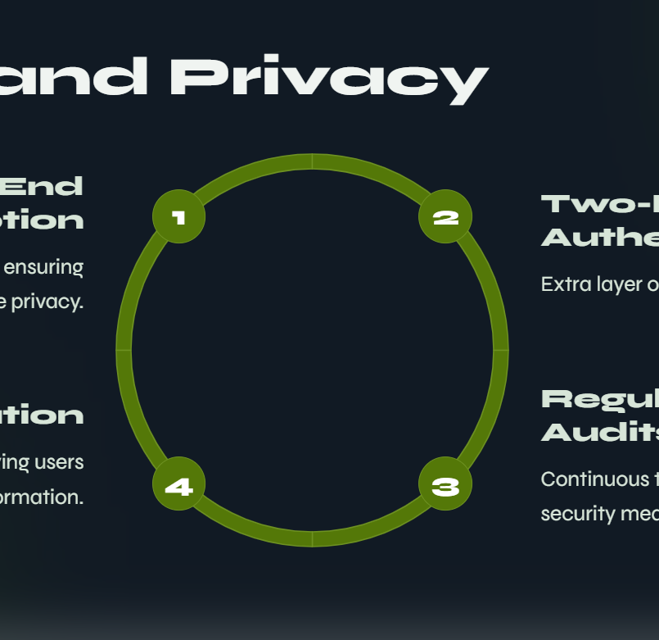
Data Encryption – Protects user data with end-to-end encryption.
Secure Login & Authentication – Multi-factor authentication (MFA) for account protection.
Role-Based Access Control – Restricts data access based on user roles (student, faculty, admin).
Privacy Controls – Users can manage visibility settings for their personal information.
Regular Security Audits – Routine checks to identify and fix vulnerabilities.
Data Anonymization – Sensitive user data is anonymized where necessary.
Secure Cloud Storage – Protected storage for academic and personal data.
No Third-Party Data Sharing – User information is not shared without consent.
Session Timeout & Auto Logout – Prevents unauthorized access after inactivity.
Report & Block Features – Users can report suspicious activity or block unwanted interactions.

Slide 7
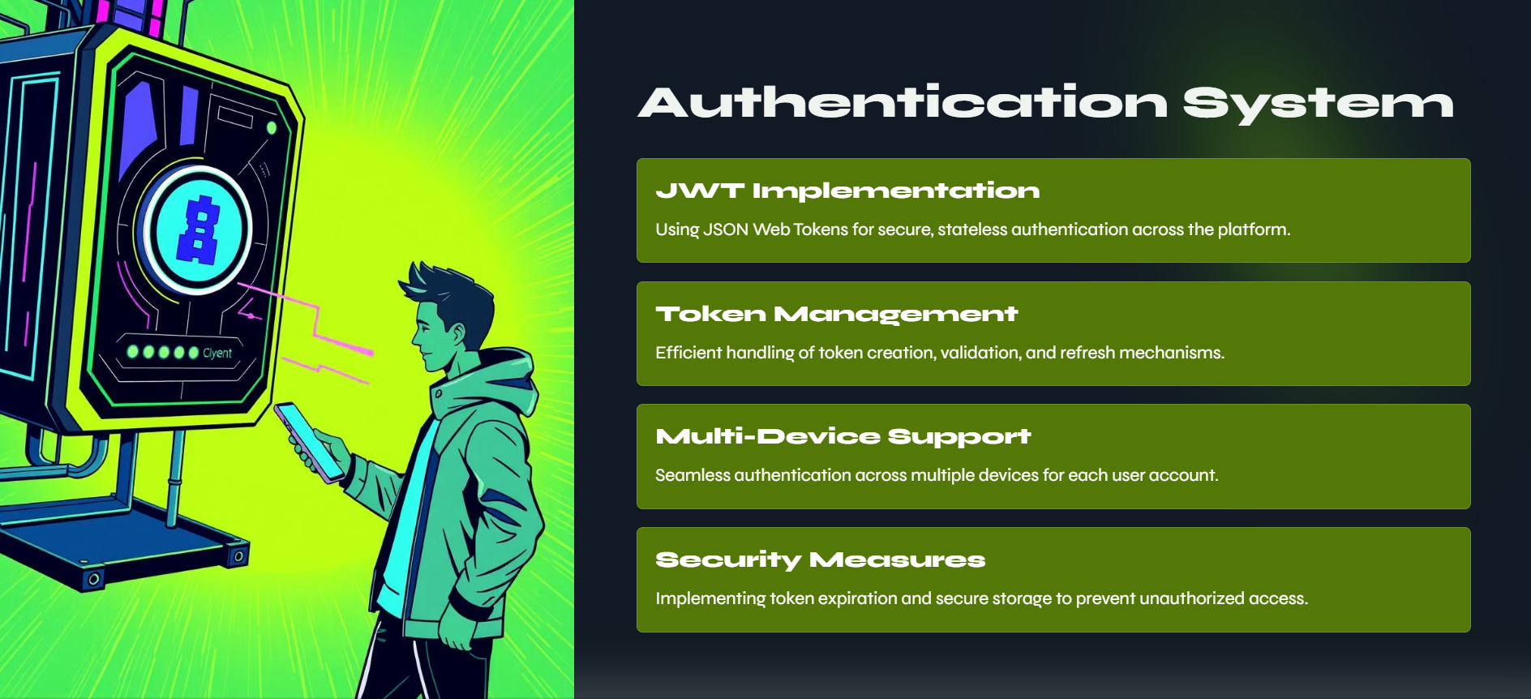
Impact on surroundings
Enhanced Campus Connectivity – Strengthens communication between students, faculty, and administration.
Improved Information Flow – Ensures timely updates on events, academics, and emergencies.
Increased Student Engagement – Encourages participation in clubs, societies, and campus activities.
Better Academic Performance – Provides easy access to study materials and academic tracking tools.
Efficient Resource Utilization – Reduces paper usage through digital announcements and notes.
Safer Campus Environment – Quick emergency alerts and reporting features improve campus security.
Stronger Alumni & Industry Relations – Facilitates networking for placements and internships.
Reduced Communication Gaps – Minimizes delays in information sharing and administrative processes.
Encourages Digital Transformation – Promotes tech-driven solutions for a smarter campus.
Positive Social Impact – Fosters collaboration, feedback culture, and a more inclusive student community.

Slide 8
Diagrams And Models Used
ER Diagram
DFD
Sequence Diagram
Class Diagram
Use Case Diagram
Waterfall Model
Rapid action Development Model
Spiral Model
Iterative Waterfall Model
Spiral Model

Slide 9
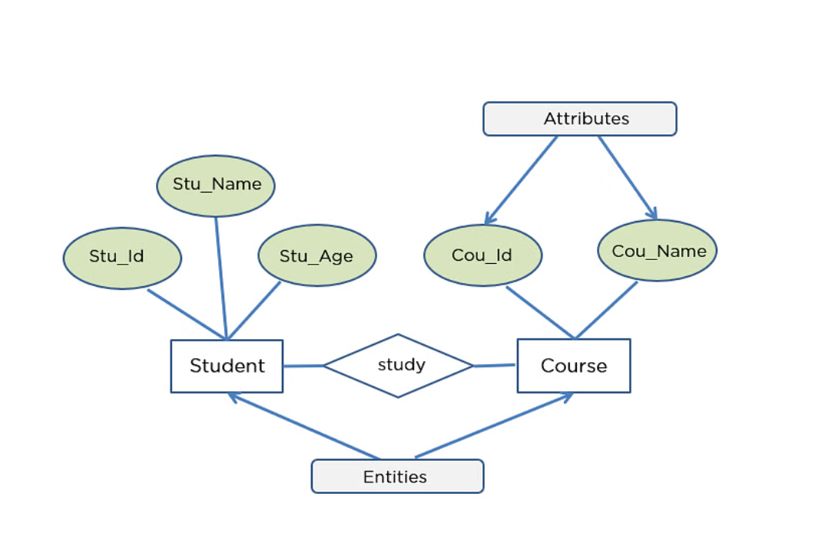
ER Diagram :

Slide 10
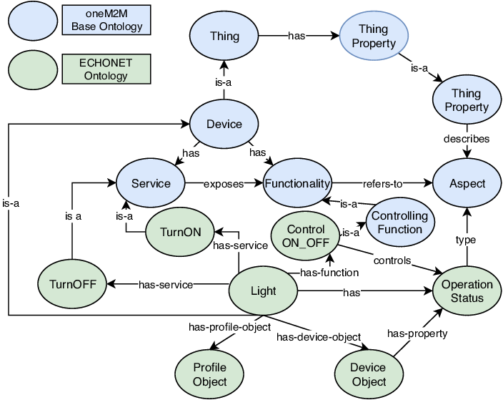
DFD’s for EchoNIT :

Slide 11
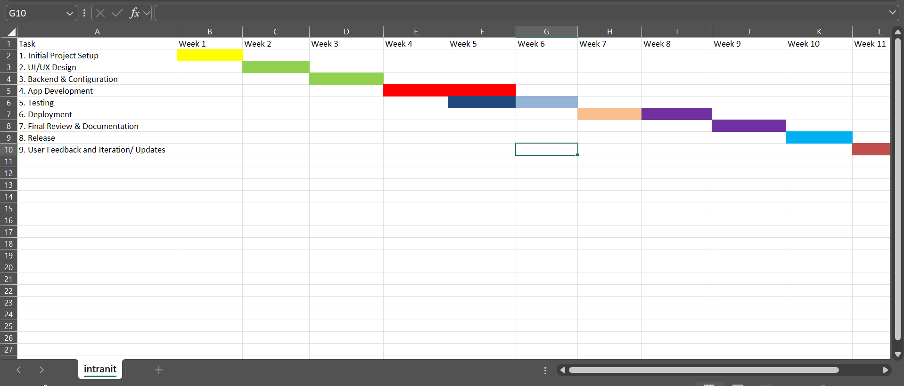

Slide 12
Sequence Diagram:

Slide 13

Use Case Diagram :

Slide 14
1️⃣ Design & Implementation – Ensures secure, scalable, and efficient architecture.
2️⃣ Real-Time Communication – Enables fast, reliable messaging with low latency.
3️⃣ User-Centered Design – Enhances UI/UX for a seamless user experience.
4️⃣ End-to-End Encryption – Ensures privacy and data security in messaging.
5️⃣ Cross-Platform Optimization – Improves performance across Android, iOS, and Web.
6️⃣ Cloud-Based Solutions – Enhances scalability, storage, and reliability.
IMPORTANCE

Slide 15

TESTING PHASE

Slide 16
1️⃣ Requirement Analysis & Test Planning
Understand project requirements and define a test strategy.
Identify tools, resources, and timelines for testing.
2️⃣ Unit Testing (Developer-Level)
Test individual components (functions, modules) for correctness.
Done using frameworks like JUnit, Mocha, Jest, etc.
3️⃣ Integration Testing
Verify interactions between different modules (e.g., chat, notifications, encryption).
Ensure smooth data flow between components.
4️⃣ Functional Testing
Validate all features like messaging, notifications, security, and user management.
Ensures the app works as intended.
5️⃣ Performance Testing
Test speed, scalability, and reliability under different loads.
Identify bottlenecks using tools like JMeter or LoadRunner.

Slide 17
6️⃣ Security Testing
Ensure end-to-end encryption works properly.
Check for vulnerabilities like SQL Injection, Cross-Site Scripting (XSS).
Use tools like OWASP ZAP, Burp Suite.
7️⃣ Usability Testing
Test UI/UX design for user-friendliness.
Collect user feedback and make improvements.
8️⃣ Compatibility Testing
Ensure the app works on Android, iOS, Web, and different browsers.
Test across different devices and screen sizes.
9️⃣ Regression Testing
Ensure that new updates don’t break existing features.
Done after bug fixes and updates.
🔟 User Acceptance Testing (UAT)
Conduct real-world testing with students, faculty, and admins.
Ensure the app meets user expectations.
Final Deployment & Monitoring
Deploy EchoNIT and monitor for real-time issues.
Gather feedback for future updates and improvements.

Slide 18
Conclusion on Testing Phases of EchoNIT
Testing is crucial to ensure EchoNIT is secure, scalable, and user-friendly. It involves unit, integration, functional, performance, security, usability, compatibility, and regression testing, followed by User Acceptance Testing (UAT). Thorough testing helps identify bugs, optimize performance, and enhance user experience, ensuring a reliable and efficient messaging platform.

Slide 19
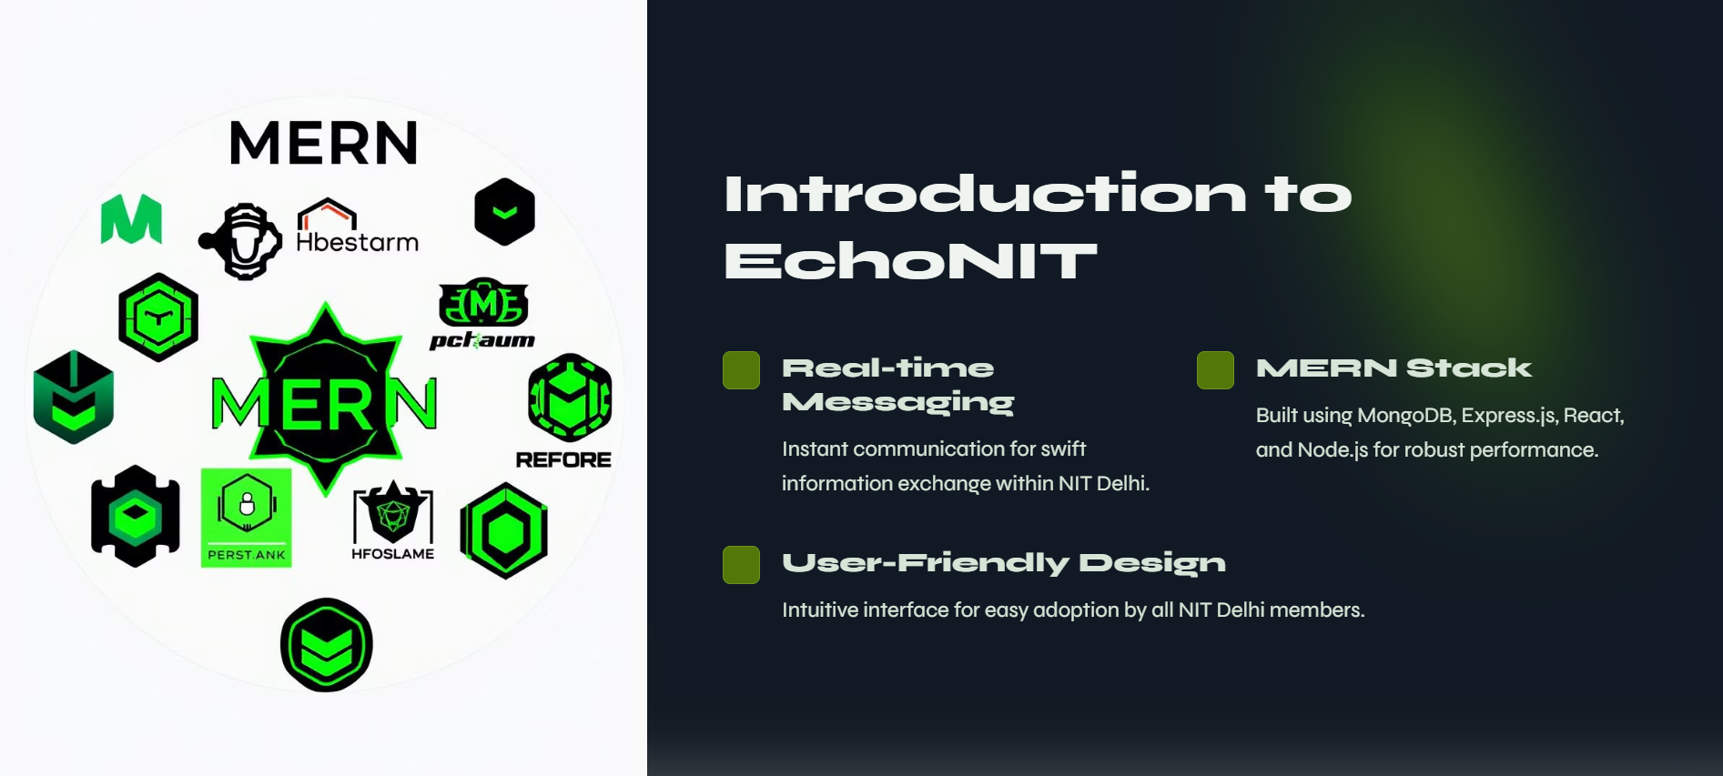
Thank You
Made By:​
Anupam Anand (221210023)
Adarsh Raj (221210007)
Ankit Jha (221210020)​

